Slide 1
Idea Validation Template

Slide 2
The opportunity
"Developing a user-friendly software solution for individuals to effectively manage their finances, track expenses, budget, and make informed financial decisions, promoting financial stability and success."
Criteria | Rank 1 - 4 | Justification for your ranking
Urgency 1 = not urgent; 2 = nice to have; 3 = critical problem; 4 = game changer if solved | 4 | Financial stress, instability, and missed opportunities demand effective personal finance management solutions.
Frequency 1 = the problem occurs once 4 = the problem occurs multiple times per day | 4 | The frequency is driven by the recurring nature of financial activities and the need for sustained financial management to maintain stability and progress towards financial objectives
Size (now and in future) 1 = only few people have the problem 4 = almost everyone has the problem or will have it in future | 4 | due to the universal need for personal finance management across diverse demographics and income levels.
Unique Insight 1 = we know as much as everyone else about the problem; 4 = we have insider knowledge that no one else has | 4 | We have insider knowledge that no one else has
Founder – Problem Fit 1 = we don’t have the skills to solve the problem; 2 = anyone else could solve the problem; 3 = we have the skills to solve the problem; 4 = we have skills, relevant insights, networks to solve the problem | 4 | We have the skills, relevant insights, networks to solve the problem

Slide 3
Customer Segments
Brainstorm as many possible customer segments who might have the problem. Validate through interviews the exact problem.
Possible Customer Segments (B2B and B2C) | Nr of interviews conducted | What specific problems is this segment facing? | Size of the segment (1 – 4) | Purchasing Power (1 – 4)
1
2
3

Slide 4
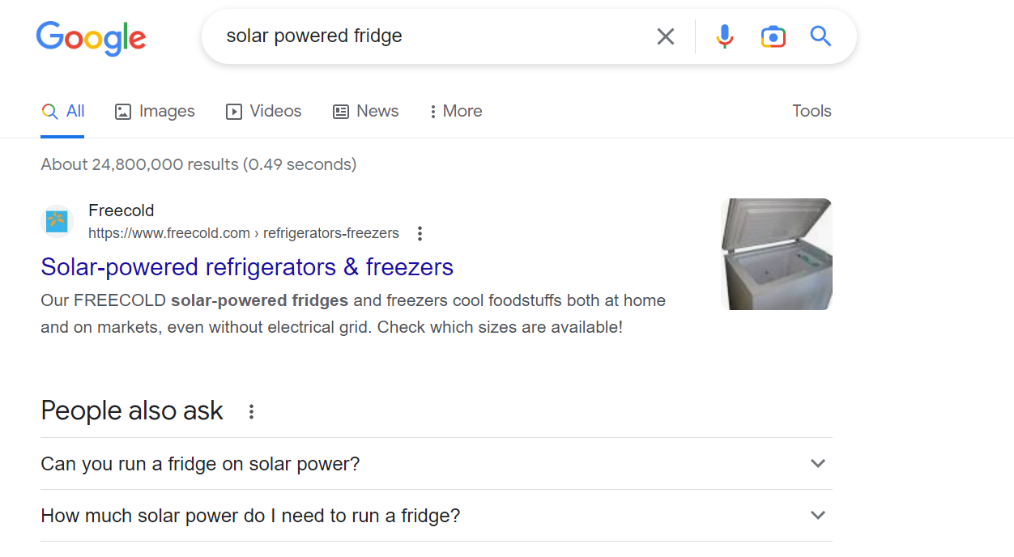
Google Research
What did you find out when you googled the problem or your idea? Which solutions already exist?
Note: Use this as a way to get first insights and understand what's happening in the world. This does not replace customer interviews or conversations with industry experts from Tanzania.
Search the problem and different phrasing of the problem
Search possible solutions you currently have in mind
Find out challenges with existing solutions
Search startups which already working on the problem
Ask ChatGPT how to solve the problem and which solutions or startups already exist?

Slide 6
Outcome Research
List here the most interesting and relevant findings from your research based on the guiding questions

Slide 8
Existing Solutions
Conduct research on existing solutions. This can be other companies or simply hacks people found to solve their problem.
Note: This info should come from customer interviews and research.
Which other solutions already exist? | What’s a weakness in the existing solution?
1
2
3
4
5

Slide 9
Brainstorm min. 3 solutions to the problem
Brainstorm min. 3 different solutions to the problem you want to solve. Don’t get stuck on only one solution.
Refer to your google research on possible solutions and learnings from interviews as well.
Overall solution | How much do you charge? | Which customer segment is it for? | Why does this work for your customer? Can your customer afford the solution?
1
2
3

Slide 10
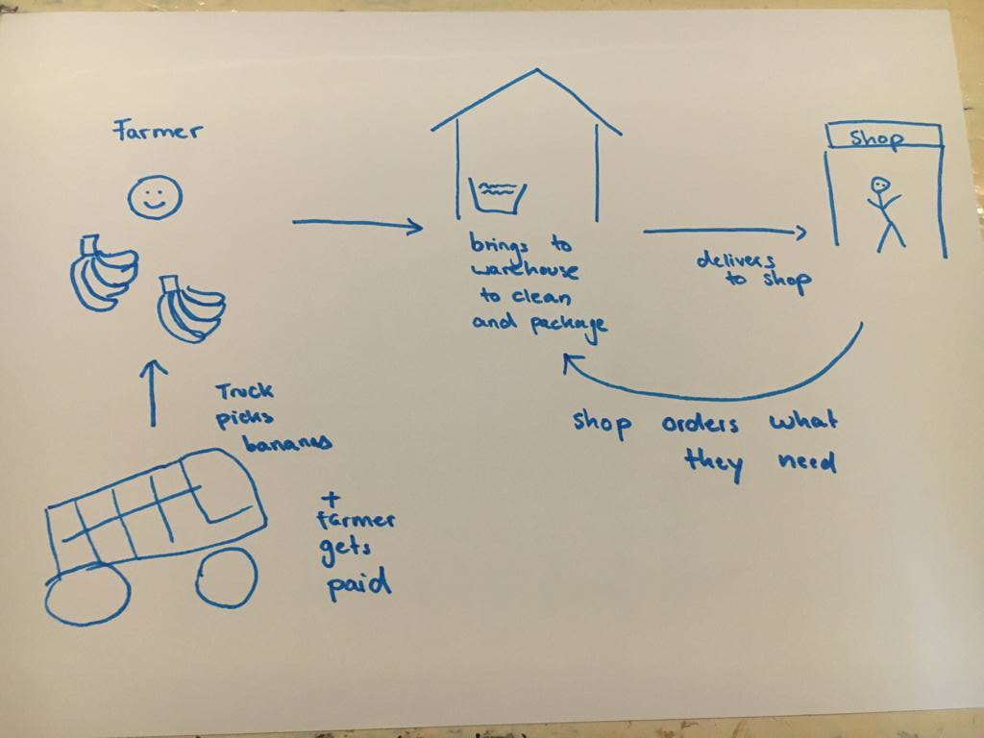
How does your solution work?
Imagine if an investor would give you all the money you want to build your solution. How exactly would it look like?
Decide for one solution and illustrate exactly how it works. You can make a drawing and take a picture and upload it on to the slides.

Slide 11
Demand Test
Show some proof of your demand test.
What did you find out?
Note: we will have a session on this during class. Wait until the session to work on this.

Slide 12
Team (Founder-Market Fit)
Name of Co-Founders | Mark the expertise of each Co-Founder | Personal Motivation to implement the idea (even when it gets hard) | Planned Equity in your startup (Total = 100%)
1 | Product building skills Sales & Communication Design Industry work experience Worked with a startup before Other (specify)
2 | Product building skills Sales & Communication Design Industry work experience Worked with a startup before Other (specify)
3

